Slide 1
Town of Hampstead 2021 Budget
Deliberative Session
Friday, February 5th

Slide 2
TOWN WARRANT
THE STATE OF NEW HAMPSHIRE
FIRST SESSION OF THE ANNUAL MEETING
(DELIBERATIVE SESSION)
FRIDAY, FEBRUARY 5, 2021
7:00 P.M.
HAMPSTEAD MIDDLE SCHOOL

Slide 3
To the inhabitants of the Town of Hampstead in the County of Rockingham in said state, qualified to vote in town affairs:
You are hereby notified to meet at the Hampstead Middle School in said Hampstead on Friday, February 5, 2021 at seven o’clock in the evening, for the explanation, discussion, and debate of each Warrant Article, and to transact all business other than by voting by official ballot.

Slide 4
SECOND SESSION OF THE ANNUAL MEETING
(VOTING)
TUESDAY, MARCH 9, 2021
8:00 A.M. TO 8:00 P.M.
HAMPSTEAD MIDDLE SCHOOL

Slide 5
To the inhabitants of the Town of Hampstead in the County of Rockingham in said state, qualified to vote in town affairs:
You are hereby notified to meet at the Hampstead Middle School in said Hampstead on Tuesday, March 9, 2021 at eight o’clock in the forenoon, to elect officers of the Town by official ballot, to vote on questions required by law to be inserted on said official ballot and to vote on all Warrant Articles from the First Session.

Slide 6
ARTICLE I
To choose all necessary town officers for the ensuing year. (By Official Ballot)
ARTICLE 2
Are you in favor of the following as proposed by the Planning Board for the Hampstead Zoning Ordinance:
To see if the Town will vote to amend Article III-5:4 A, In Commercial Zone C2 by replacing the existing language with the following: “The minimum lot size shall be the appropriate square footage required under Article II-1 (Soil-based Lot Size) and Article II-2 (Wetlands Ordinance) for the soil and slope which constitute such lot, or 45,000 square feet, whichever is larger.”
Recommended by the Planning Board

Slide 7
ARTICLE 3
Are you in favor of the following as proposed by the Planning Board for the Hampstead Zoning Ordinance:
To see if the Town will vote to adopt Article I-2:3 Building Permits Required, Under General Provisions, “C. For any Building Permit issued which includes elements of roofing, siding, windows, and doors; these exterior elements must be completed within 12 months of issuance of said Building Permit.”
Recommended by the Planning Board

Slide 8
ARTICLE 4
Are you in favor of the following as proposed by petition to the Planning Board for the Hampstead Zoning Ordinance:
To see if the Town will vote to rezone the land consisting of the area on the Northerly side of Route 111, bounded on the Northeast by the existing C-2 Zone at Map 12, Lot 15, bounded on the Southwest by Village Green Road, bounded on the East by Route 111 and bounded on the Northwest by a line which is four hundred feet (400’) distant from the Northerly line of Route 111, from Zone A (Residential) to Zone C-2 (Commercial).
Recommended by the Planning Board

Slide 9
ARTICLE 5
Are you in favor of the following as proposed by the Planning Board for the Hampstead Zoning Ordinance:
To see if the Town will vote to adopt Article I-2:10 Unregistered Motor Vehicles and Boats, Under General Provisions, “No lot in the Residential or Recreational Districts may be used for the outside storage of more than two unregistered and/or uninspected motor vehicles. No more than one unregistered boat shall be permitted on a lot.”
Recommended by the Planning Board

Slide 10
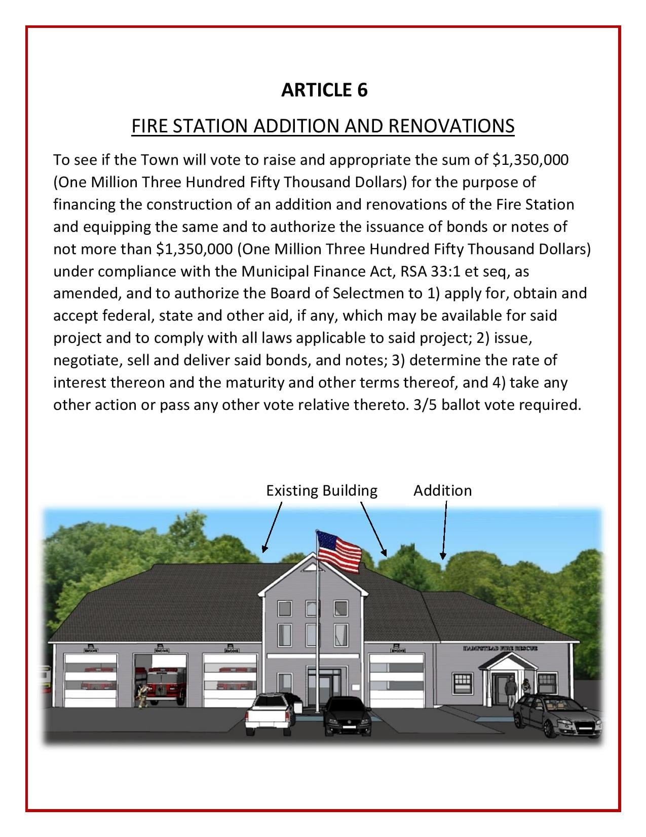

Slide 11
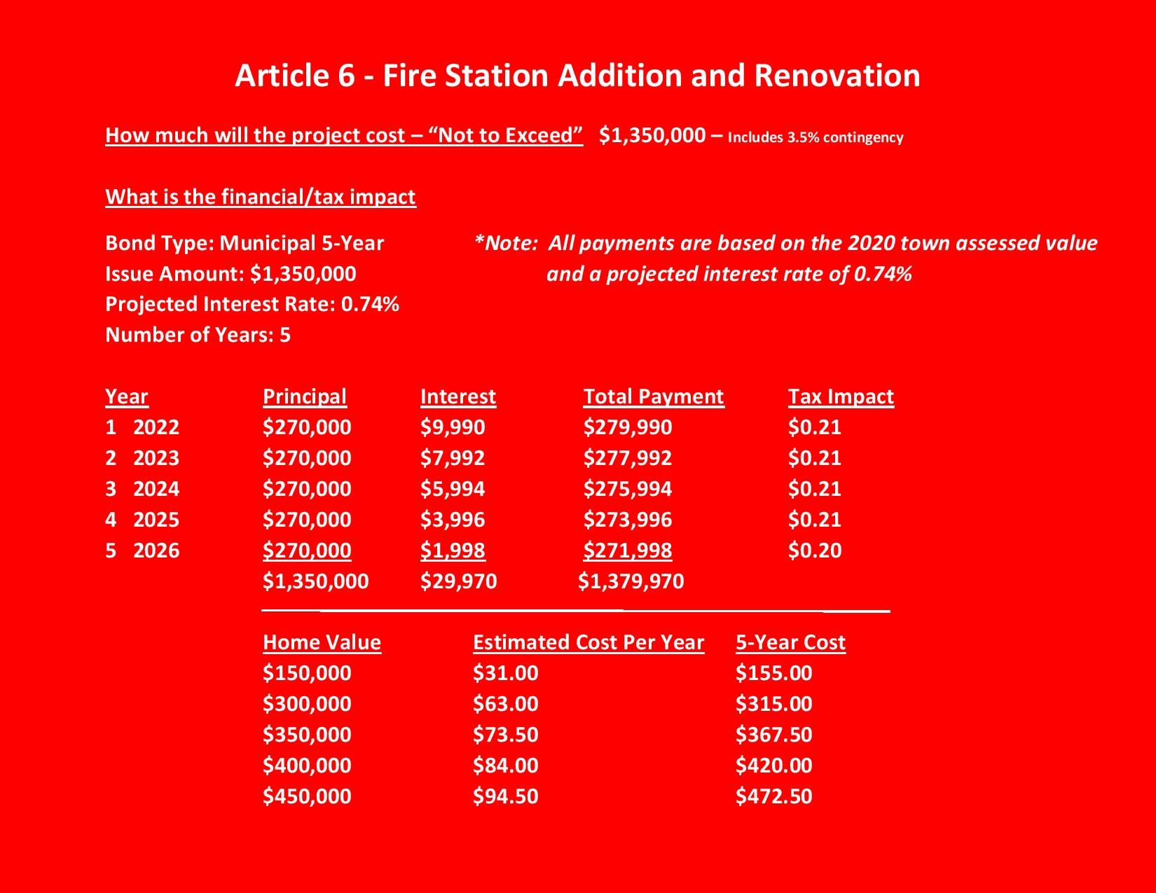

Slide 12
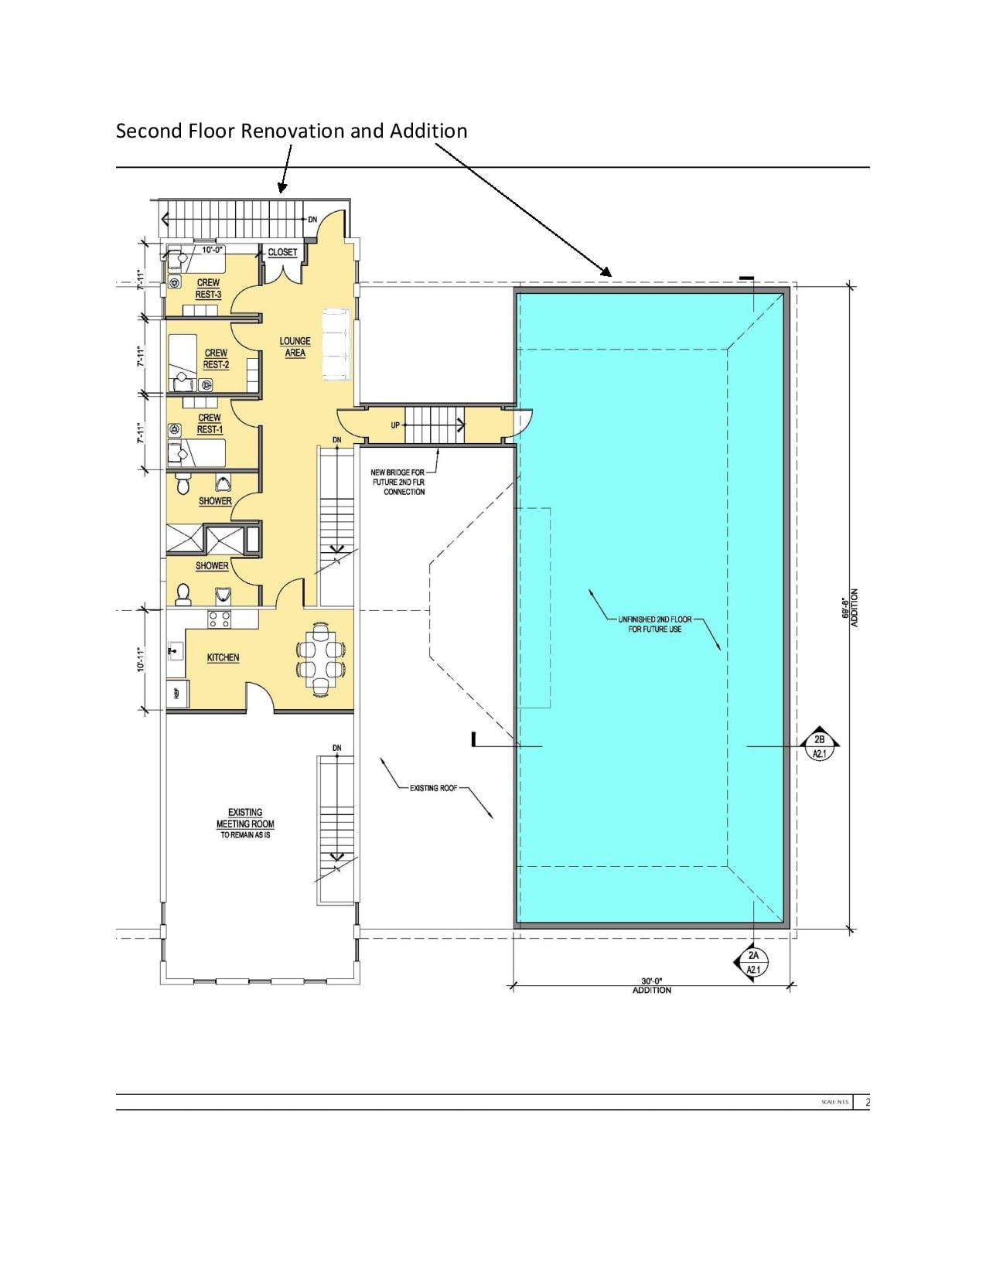

Slide 13
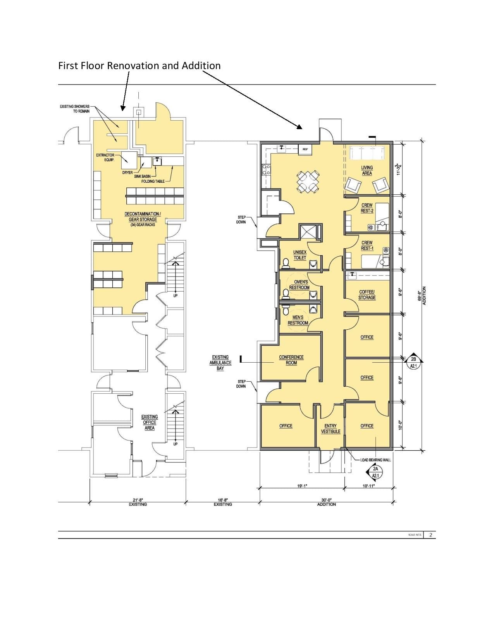

Slide 15
ARTICLE 7
To see if the Town will vote to raise and appropriate as an operating budget, not including appropriations by special warrant articles and other appropriations voted separately, the amounts set forth on the budget posted with the warrant or as amended by vote of the first session, for the purposes set forth therein, totaling $7,502,460 (Seven Million Five Hundred Two Thousand Four Hundred Sixty Dollars). Should this article be defeated, the default budget shall be $7,500,400 (Seven Million Five Hundred Thousand Four Hundred Dollars) which is the same as last year, with certain adjustments required by previous action of the Town or by law; or the governing body may hold one special meeting in accordance with RSA 40:13 X and XVI, to take up the issue of a revised operating budget only.
Recommended by the Board of Selectmen 3-0
Recommended by the Budget Committee
3-0 (advisory only)

Slide 16
ARTICLE 8
To see if the Town will vote to approve the cost items included in the 3-year collective bargaining agreement reached between the Hampstead Board of Selectmen and the New England Police Benevolent Association Local No. 37 of New Hampshire, effective April 1st, 2021, which calls for the following increases in salaries and benefits at the current staffing levels:
Estimated Increase:
 |  | Fiscal |  | Fiscal |  | Fiscal | Fiscal
 |  | Year 1 |  | Year 2 |  | Year 3 | Year 4
 |  | 9 months |  | 12 months |  | 12 months | 3 months
Salary Changes | wages | $15,544 |  | $20,180 |  | $21,259 | $ 5,438
Shift Differential |  | $ 4,483 |  | $ 1,493
NHRS | 33.88% | $ 5,759 |  | $ 6,490 |  | $ 6,212 | $ 1,561
FICA and Medicaid | 7.65% | $ 478 |  | $ 498 |  | $ 490 | $ 113
 |  | $26,264 |  | $28,662 |  | $27,961 | $7,112
Benefits |  | $ 1,312 |  | $ 437
TOTAL |  | $27,576 |  | $29,099 |  | $27,961 | $7,112

Slide 17
and further to raise and appropriate the sum of $27,576 (Twenty Seven Thousand Five Hundred Seventy Six Dollars) for the current fiscal year, such sum representing the additional cost attributable to the increase in salaries and benefits over those of the appropriation at current staffing levels paid in the prior fiscal year.
Recommended by the Board of Selectmen 2-1
Recommended by the Budget Committee 3-0 (advisory only)

Slide 18
ARTICLE 9
Shall the Town, if Article #8 is defeated, authorize the Board of Selectmen to call one special meeting, at its option, to address Article #8 cost items only.
Recommended by the Board of Selectmen 3-0

Slide 19
ARTICLE 10
To see if the Town will vote to raise and appropriate the sum of $10,000 (Ten Thousand Dollars) to be placed in the existing Hampstead Public Library Building Maintenance Non-Capital Reserve Fund.
Recommended by the Board of Selectmen 2-1
Recommended by the Budget Committee 3-0 (advisory only)
Balance is at $13,777 at 12.31.20

Slide 20
ARTICLE 11
To see if the Town will vote to raise and appropriate the sum of $1,000 (One Thousand Dollars) to Rockingham Meals on Wheels for transportation services.
Recommended by the Board of Selectmen 3-0
Recommended by the Budget Committee 3-0 (advisory only)

Slide 21
ARTICLE 12
To see if the Town will vote to raise and appropriate the sum of $9,000 (Nine Thousand Dollars) for Community Caregivers.
Recommended by the Board of Selectmen 3-0
Recommended by the Budget Committee 3-0 (advisory only)

Slide 22
ARTICLE 13
To see if the Town will vote to raise and appropriate the sum of $3,070 (Three Thousand and Seventy Dollars) for Haven.
Recommended by the Board of Selectmen 3-0
____by the Budget Committee (advisory only)

Slide 23
ARTICLE 14
To make mandatory that every town board post all meeting agendas to the town website, and send them via the town email list, no later than two (2) business days prior to the board meeting - this article also seeks to disallow discussion of any items that do not appear on the agenda, and to disallow any items to be added to the agenda within 2 business days of the meeting. This article seeks to promote transparency, and to give all residents ample time to plan in the event that they want to attend a meeting based on the topics being discussed. By Petition
Not recommended by the Board of Selectmen 0-3

Slide 24
ARTICLE 15
To make mandatory that every town board publicly post meeting minutes (draft minutes are acceptable) to the town website no later than 5 business days after each meeting (or within 72 hours for nonpublic meetings), and email notification once minutes are posted via the town email list. This article seeks to promote transparency, and to ensure that timely information is easy to find in one centralized location. By Petition
Not recommended by the Board of Selectmen 1-2

Slide 25
ARTICLE 16
To remove all board recommendations from the ballot. This article seeks to ensure that each voter is heard without being swayed or influenced by board recommendations. Ballots exist to obtain voter opinions, but they should never tell a resident how to vote – board recommendations bias the ballot, and ballots should be unbiased. By Petition
Not recommended by the Board of Selectmen 0-3

Slide 26
ARTICLE 17
To make mandatory that all town board meetings be accessible via Zoom (or a similar software that allows residents to not only remotely view the meeting live, but also interact and pose questions). While Hampstead Cable TV is a great resource, many residents do not have cable television – furthermore, the public cannot interact with televised meetings. This article seeks to assure that all residents have the ability to attend town board meetings, remotely or in person, in a way that is convenient for them. By Petition
Not recommended by the Board of Selectmen 0-3

